Slide 1

Apache Flink
ASSIGNMENT
1
Team 10
Usama Bakkar
Naif Alenazi
Anas Alhanaya

Slide 2
Table of
Contents
  Overview
  Justification
  Installation
  Experimentation
  Results
  Critical Analysis

Slide 3

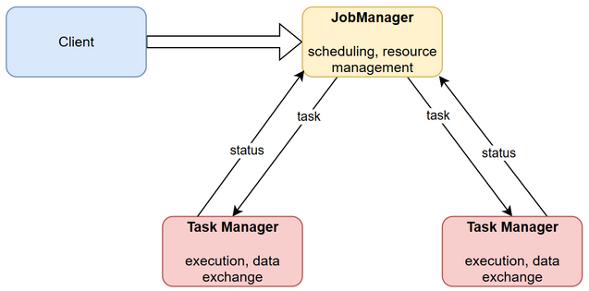
Overview
APACHE FLINK
Architecture:
  Client
  JobManager
  TaskManager
Purpose:
Fast, reliable, and scalable processing of stream and batch data in distributed environments.
Capabilities:
  Unbounded (stream) / bounded (batch)
  Stateful computations with fault tolerance
  In-memory performance
  Horizontal scalability

Slide 4


Justification
APACHE FLINK
  Unified engine for both batch and streaming workloads
  Built for scalable, distributed data processing
    Shown in experimentation results
  Strong fault tolerance
  In-memory execution for high performance
    Overall fast, but subsequent runs were faster as well
  Chosen over Spark/Hadoop for its modern architecture and native support for both data-parallel and task-parallel computation
SPARK
HADOOP

Slide 5
Installation
APACHE FLINK
Steps:
  Install Docker Desktop
  Get docker-compose.yml (Session Mode vs. Application Mode)
  Run docker compose up in a terminal
  Scaled with docker compose up -d --scale taskmanager=<N>
  Access Flink Web UI at http://localhost:8081
Environment: Local cluster using Docker Compose on Windows with WSL2 backend. 1 JobManager + 1-3 TaskManagers. This enabled isolated and repeatable experiments with minimal overhead.
Challenges:
  File-visibility issues between containers (resolved with consistent paths and permissions)
  Slow I/O on Windows bind mounts (resolved by copying data inside containers)
More details can be found in the README file (i.e. docker-compose.yml and Web UI screenshot).

Slide 6
Experimentation
APACHE FLINK
Workload: Word count, which is a computational and analytical task.
Datasets:
  Small (~2 MB)
  Medium (~29 MB)
  Large (~81 MB)
Experimental variables:
  Data volume (small → medium → large)
  Compute nodes (1 TM, 2 TMs, 3 TMs)
Measured metrics: The execution time (ms), CPU %, Memory %, and Network I/O were measured per variable value, while keeping other variables fixed, and documented in a tabular format.
Goal: Evaluate scalability and performance under varying data volumes and compute resources.
More details can be found in the README file (i.e. commands executed and exact values).

Slide 7
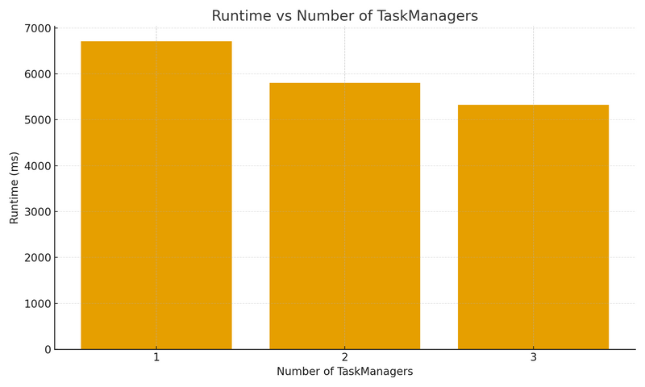
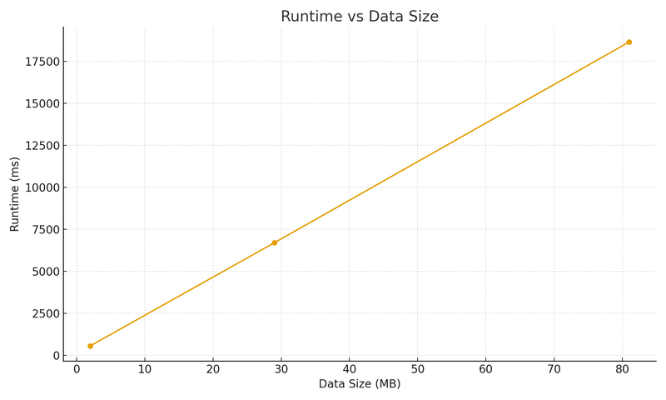
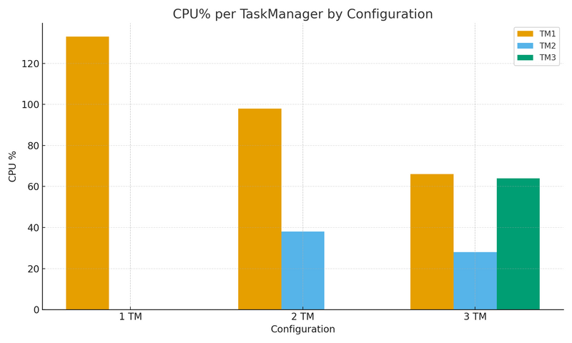
Results
APACHE FLINK
  Data scaling: Time grew linearly with size, confirming predictable throughput and efficient scaling.
  Parallel execution: CPU usage/node decreased as workload was distributed across more TMs.
  Scalability: Adding nodes reduced runtime but with diminishing returns due to network and coordination overhead.
  Network impact: Higher inter-node shuffling increased I/O in multi-node runs, showing distributed communication.
More details can be found in the README file (i.e. comments per experiment variable).

Slide 8
Critical Analysis
APACHE FLINK
Strengths:
  Handles larger datasets and nodes efficiently.
  Linear scaling with data volume, stable memory use.
  Same engine for batch and stream jobs.
  Fault tolerant.
Limitations:
  Short jobs suffer from JVM and submission latency.
  Multi-node increases shuffle/coordination overhead.
  Requires careful file visibility and permissions.
  Slow Windows I/O compared to Linux environments.
Possible improvements:
  Use native Linux or cloud clusters for more realistic performance.
  Automate data distribution with HDFS/S3 instead of manual copying.
  Integrate Flink SQL or Kafka to explore streaming workloads.
  Enable profiling dashboards for deeper analysis.

